Slide 1
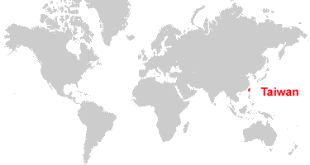
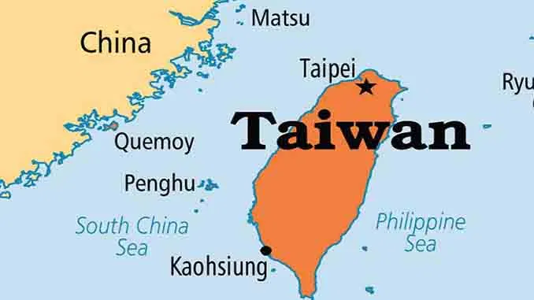
Chiang Kai-Shek (Jiang Jieshi) and His Family in Taiwan
*maps are from Geology.com
Notes:
Here are two maps to show you where Taiwan is

Slide 2
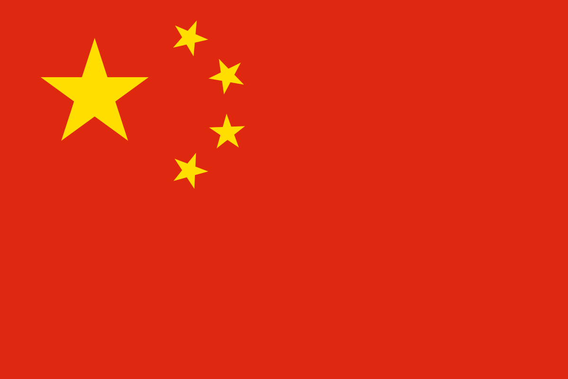
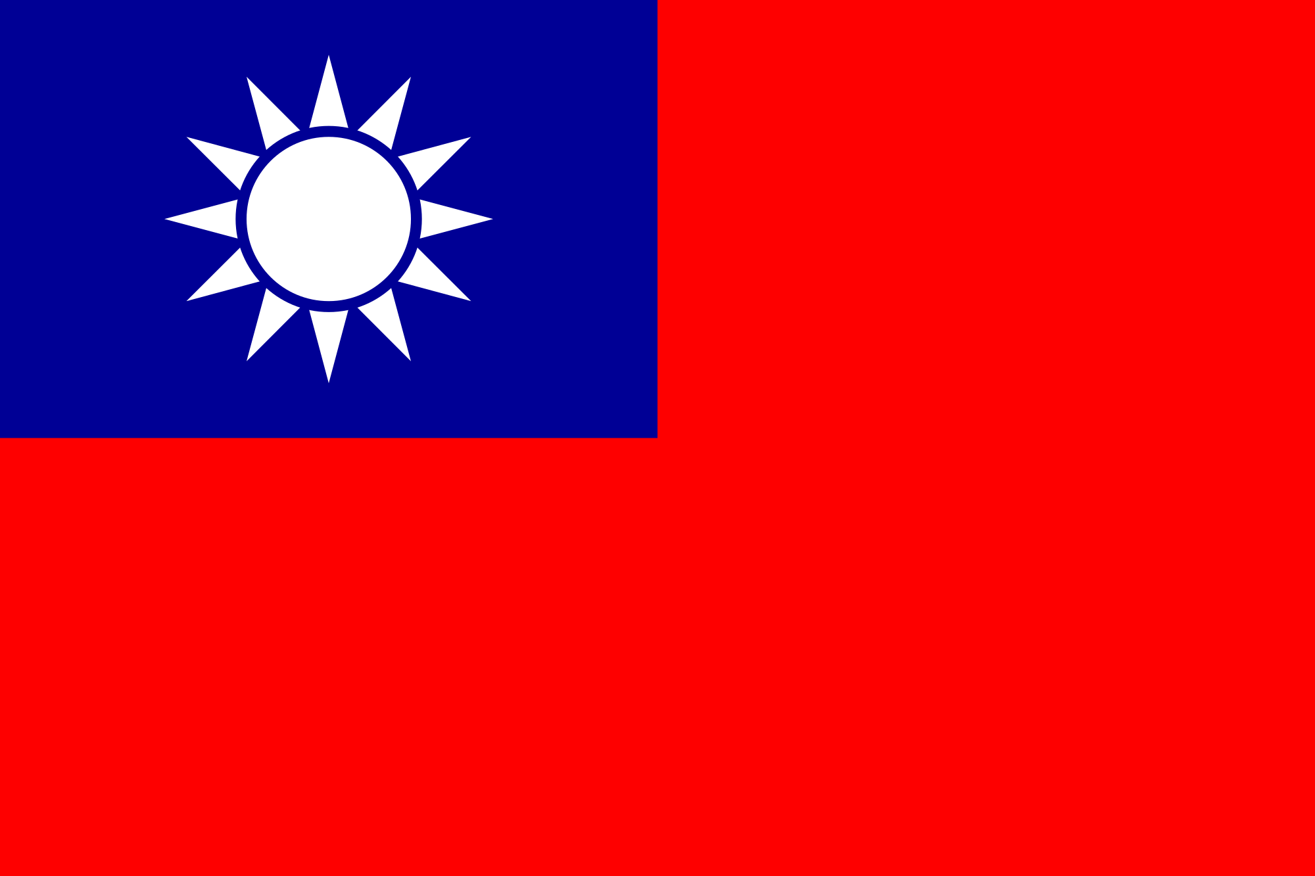
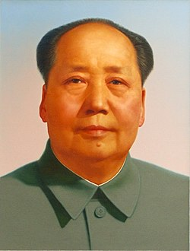
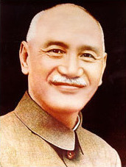
*Pictures are from Google images
Notes:
There was a civil war in China in the 30’s and 40’s, which was the opposition between Mao Zedong and Jiang Jieshi, then Mao became the leader of Mainland China until 1976 when he passed away. On the other hand, Jiang Jieshi moved his 2 million soldiers and civilians to Taiwan in 1949, since then he became the leader in Taiwan until 1975 when he passed away.

Slide 3
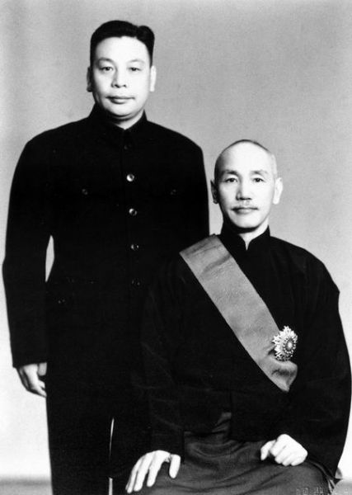
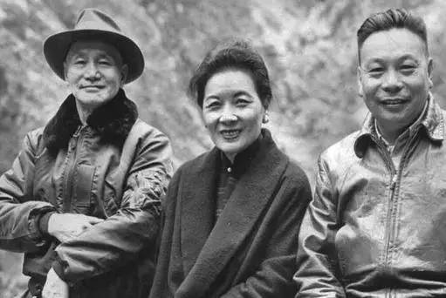
*Pictures are from Google images
Notes:
Jiang Jieshi and his wife Song Meiling launched Taiwan on the path of economic modernization, later Jiang Jieshi’s son Jiang Jingguo continued the development by carrying out land reform and promoting the “Ten Major Construction Projects” which helped Taiwan economic globalization

Slide 4
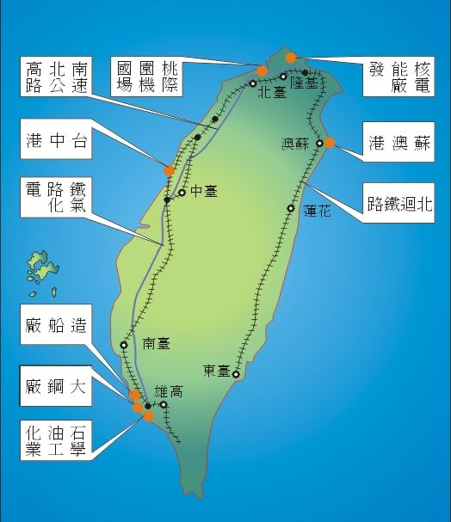
*International Airport
*National Highway
*Nuclear Power Plant
*Taichung Port
*Su-Ao Port
*Electrification of
Western Line Railway
*North-Link Line Railway
*Shipbuilding Corporation
*Steel Factory
*Oil Refinery and
Industrial Park
*Pictures are from Google images
Notes:
Here’s the Map of the Ten Major Construction Projects, most of the projects started in 1974 and completed in 1979

Slide 5
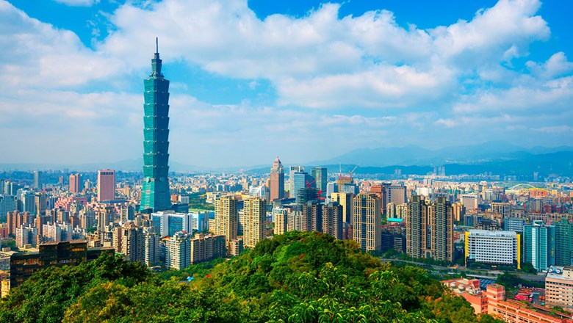
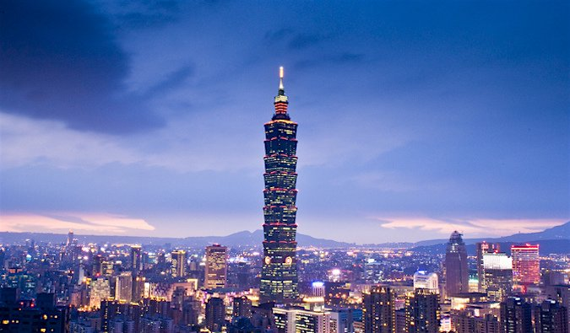
*Pictures are from Google images
Notes:
Taipei 101, located in my hometown Taipei, is the tallest building in Taiwan (it was the world’s tallest building from 2004-2010) These beautiful pictures show Taipei 101 during the day and the night

Slide 6
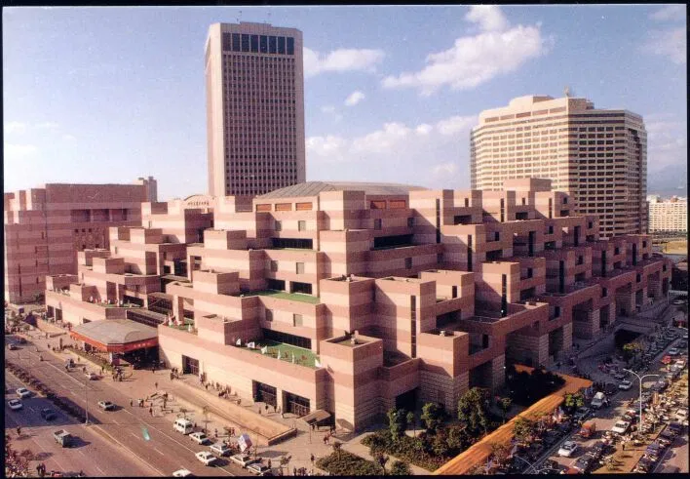
*Pictures are from Google images
Notes:
One more picture to show you Taiwan’s modernization, The World Trade Center in Taipei, I had the privilege to work there for a year when I was in college (1990).

Slide 7
Taiwan Healthcare System
*Taiwan started a national “health for all” system in 1995.
*Pros: the system provides good accessibility, comprehensive
population coverage, short waiting times, low cost, and
national data collection systems for planning and research.
*Cons: short consultation time and poor gatekeeping of specialist
services.
Resource: https://www.ncbi.nlm.nih.gov/pmc/articles/PMC3960712/

Slide 8
How Taiwan fights COVID
*Please watch this video: https://www.youtube.com/watch?v=XjqD_9ScTlA
*Please watch this video: https://www.youtube.com/watch?v=wmK9Bt1xcnY

